Slide 1
The Role of Scientists in Reducing Nuclear Threats
Michiji Konuma mkonuma@keio.jp
Professor Emeritus, Keio University, Tokyo Japan
Former member, Pugwash Council (1992 – 2002)
PL7, The 63rd Pugwash Conference
Hiroshima, Japan
2 November 2025

Slide 2
Contents
1 Brief self-introduction
2 Threats/nuclear threats
3 Role of nuclear weapons
4 nonparticipation to the Military research
5 Giving-up?/Despair?/Hope
6 To new Pugwashites
7 Conclusion

Slide 3
1 Brief self-introduction
1931 born in Tokyo theoretical physicist
1957 August I followed Sin-itiro Tomonaga to meet Joseph Rotblat in Tokyo and heard directly his report on the 1st Pugwash Conference.
a founding member of “Pugwash Japan” (then a graduate student).
The first task: discussions on the agenda of the 2nd Conference. We sent “A statement of 21 Japanese physicists who support the Pugwash Conferences” to the 2nd Conference (Lac Beauport, Canada)
The second task: Tomonaga organized weekly meetings to study the Minutes and Documents of the 2nd and 3rd Pugwash Conferences. (311 pages and 295 pages)
I attended first the 14th Pugwash Conference (Venice, Italy, 1965).
Pugwash Council member from 1992 to 2002

Slide 4
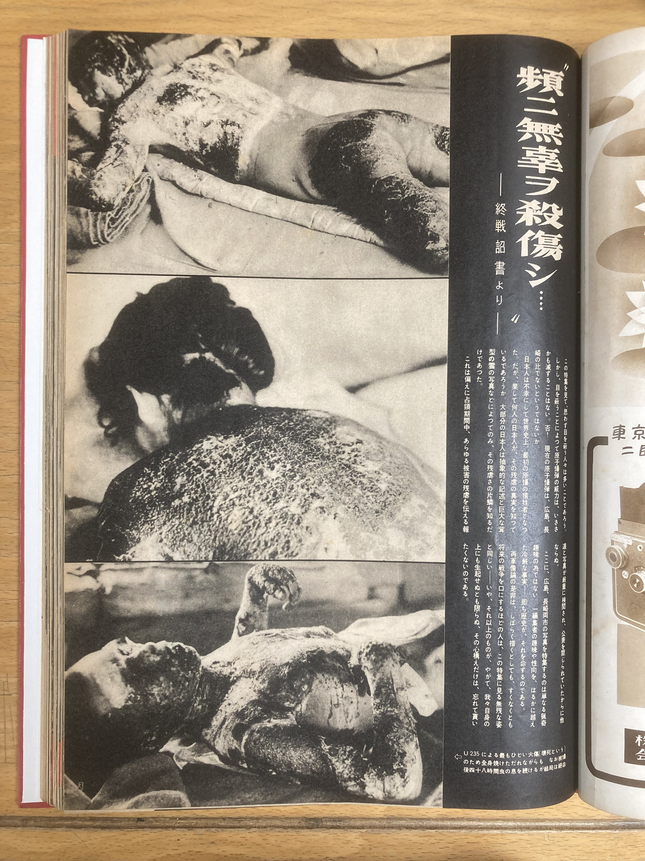
Asahigraph
August 6, 1952
Weekly photographic magazine
I was shocked at grievous photos of Hiroshima and Nagasaki.
P.1 killed and wounded guiltless people
(Next slide)
Pp. 2-3 Hiroshima, The first sacrifice city

Slide 5
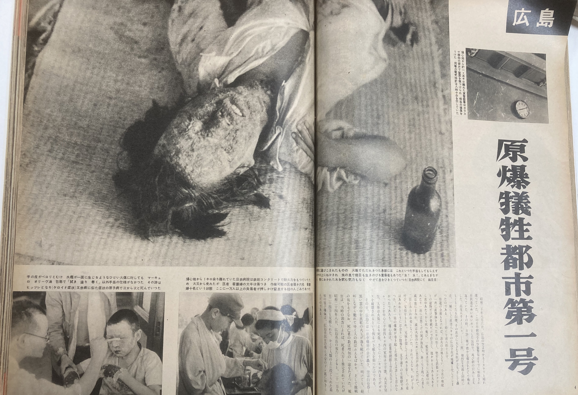

Slide 6
The statement of 21 Japanese physicists who support the Pugwash Conferences, April 3, 1958 (I was the youngest.)
This statement was sent by telegram from Hideki Yukawa to Bertrand Russell c/o the 2nd Pugwash Conference.
Joseph Rotblat introduced this statement at the 6th meeting of the 2nd Pugwash Conference.
1 prompt unconditional prohibition of nuclear weapon tests
2 We don’t participate any nuclear weapon research. Support the Goettingen Statement.
3 Balance of power accelerates armament race
4 scientific information should be open to public.
5 International collaboration on radiation hazard and detection of nuclear explosion・・・

Slide 7
2 Threats/Nuclear threats
CHARTER OF THE UNITED NATIONS
WE THE PEOPLES OF THE UNITED NATIONS DETERMINED to save succeeding generations from the scourge of war, which twice in our lifetime has brought untold sorrow to mankind,
AND FOR THESE ENDS to practice tolerance and live together in peace with one another as good neighbors, and to unite our strength to maintain international peace and security, and to ensure, by the acceptance of principles and the institution of methods, that armed force shall not be used, save in the common interest,

Slide 8
CHARTER OF THE UNITED NATIONS
CHAPTER I PURPOSES AND PRINCIPLES
Article 2 3. All Members shall settle their international disputes by peaceful means in such a manner that international peace and security, and justice, are not endangered.
4. All Members shall refrain in their international relations from the threat or use of force against the territorial integrity or political independence of any state, or in any other manner inconsistent with the Purposes of the United Nations.

Slide 9
The Constitution of Japan
Preamble. ・・・We recognize that all peoples of the world have the right to live in peace, free from fear and want.・・・
Article 9. Aspiring sincerely to an international peace based on justice and order, the Japanese people forever renounce war as a sovereign right of the nation and the threat or use of force as means of settling international disputes.

Slide 10
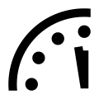
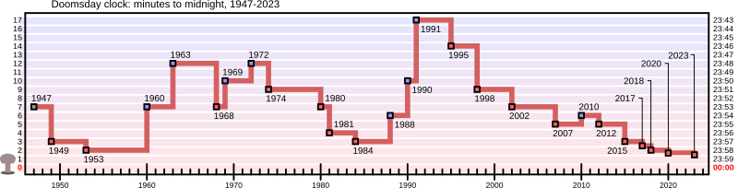
Bulletin of the Atomic Scientists
Doomsday Clock
1947～ The start was 7 minutes to the midnight which corresponds to the nuclear apocalypse of the earth.
The clock shifts forward for increasing nuclear danger, and backward for decreasing.
Forward shifts 18 times and backward shifts 8 times.
2025 90 s ⇒ 89 s the shortest to the midnight.

Slide 11
8 times of reducing nuclear threats
1960 International Geographic Year (IGY); Pugwash Conf.
1963 Partial Test Ban Treaty (PTBT); Cuban Missile Crisis
1969 Treaty on the Non-Proliferation of Nuclear Weapons (NPT)
1972 Strategic Arms Limitation Treaty (SALT); Anti-Ballistic Missile Treaty (ABM)
1988 Intermediate-Range Nuclear Forces Treaty (INF)
1990 Fall Berlin Wall; End of the Cold War
1991 Strategic of the Arms Reduction Treaty (SALT)
2010 UN Climate Chage Conference in Copenhagen
2018 Treaty on the Prohibition of Nuclear Weapons (TPNW); misuse of information technology; misuse of social media (2 ½ minutes ⇒ 2 minutes)

Slide 12
The present anxious world
Intensive modernization of the nuclear weapon systems
Nuclear threat / deployment of nuclear weapons in east Europe
Maintenance of the world order not by rational but by power
Invasion of Ukraina
Slauter/Massacre/Genocide at Gaza
Abuse of veto powers at the Security Council, UN
South Korea to build Nuclear Submarines in U.S. (To rise tensions and to trigger military build-up in Asia)
President Donald Trump: Nuclear weapon test (his deal ? or super modernization?)
・・・

Slide 13
3 Role of Nuclear Weapons (NWs)
NWs are real arm.
NWs are mass destructive weapons which are against humanity.
Politicians in nations having NWs or depending on the extended nuclear deterrence seem to believe that the NWs have magic powers and bring peace and security, i.e. a powerful talisman.
If they claim a policy that they will never use NWs, this statement is not regarded as the truth or the power of NWs is immediately lost. ⇒ NWs are real arm sometime to be used if they want Once NWs are used, attackers must prepare for receiving counterattack. Some other nations wish to follow.
There is no safe place on earth in the missile era.
The nuclear explosion contaminates all over the world.
NWs should and will be prohibited. War too should and will be banned.

Slide 14
4 Nonparticipation to Military Research
1979~1991 Our President Hussain Al-Shahristani endured 11 years of imprisonment and torture under the regime of Saddam Hussein for refusing to cooperate in the development of NWs.
1957 In Germany Konrad Adenuer regime planed a nuclear weapon program. On April 12 the Goettingen Declaration was issued by 18 scientists saying not to participate the program. On April 17 Prime minister Adenauer met representative of these scientists and stopped the plan. On April 25 at the General Assembly of Science Council of Japan, a Japanese translation of this Declaration was distributed.

Slide 15
Science Council of Japan (JSC/SCJ)
A governmental organization / representative of scientists independent sratus from the Government
1949 inauguration on deep reconsideration of the attitude of our scientists in the past
1950 statement: to abstain from any cooperation with research work geared to war
1967 statement: not to participate military research
2017 statement The new large fund of Defense Equipment Agency should be carefully dealt.
Conflict between militarized government and industry versus SCJ
2026 October: Repeal of the present SCJ and conversion into the new SCJ as a corporation under severe control by the Government

Slide 16
5 Giving-up ?/Despair ?/Hope
Any change, reform and revolution started from minority in the history.
The world has repeatedly changed forward or backward.
Nuclear weapons and other mass destructive weapons and the war itself are clearly against humanity.
We must abolish NWs and war.
If we feel tired or powerless that is the end.
Keeping our solidarity among different generation we shall overcome difficulties.

Slide 17
6 To new Pugwashites first reading as introduction to the roll of scientists
The Franck Report ”Political and Social Problem”
The scientific advisory panel chaired by James Franck that compiled the report included: Donald J. Hughes, James J. Nickson, Eugene Rabinowitch, Glenn T. Seaborg, Joyce C. Stearns, and Leo Szilard.
The original sixteen-page report ”Political and Social Problem” is attached to Arthur H. Compton’s introductory synopsis for the Secretary of War dated 12 June 1945.
Further reading
The Nobel Lectures by Joseph Rotblat and John Holdren 1995
The United Nations Charter in 1945
Treaty on the Prohibition of Nuclear Weapons 2017 (TPNW)

Slide 18
7 Conclusion
I have learned various important matters from many Pugwashites.
There will be many difficulties and hopes rom now.
I trust and expect younger Pugwashites.
I also shall continue my efforts together with you.
Remember your humanity and forget the rest.

Slide 19
Contents
1 Brief self-introduction
2 Threats/nuclear threats
3 Role of nuclear weapons
4 nonparticipation to the Military research
5 Giving-up?/Despair?/Hope
6 To new Pugwashites
7 Conclusion

