Slide 1
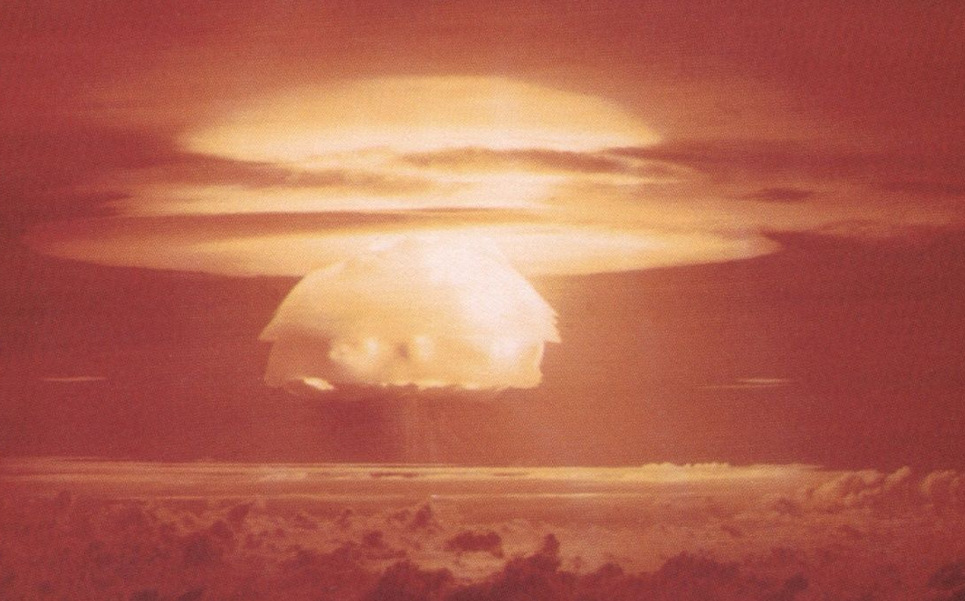
60 Years after the Russell-Einstein Manifesto:
What Next
An intergenerational dialogue
60 Years after the Russell-Einstein Manifesto: What Next
Intergenerational Imperatives
61st Pugwash Conference on Science & World Affairs
5 November 2015
Ioujima, Nagasaki

Slide 2
Goals of this session
“Memory keepers”/”story tellers” – a local tradition we should apply to Pugwash
A few slides/quotes from history
Comments from Michiji Konuma (maybe the first Student/Young Pugwash member?)
ISYP call to action
Discussion – Q&A with ISYP with Anna Peczeli and Karim Kadry, and others

Slide 3
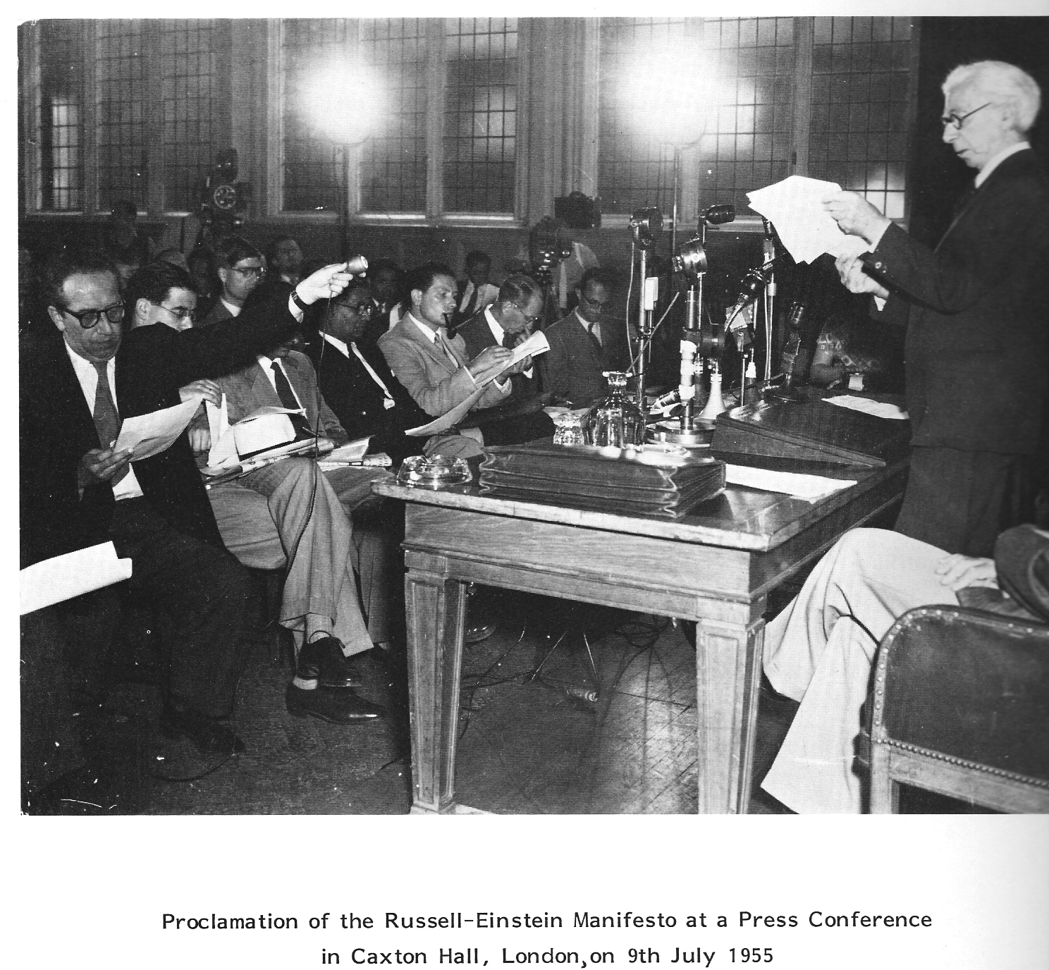
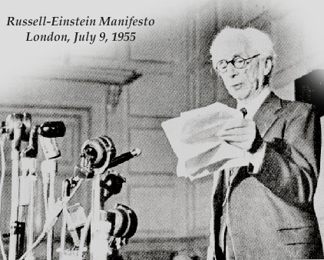
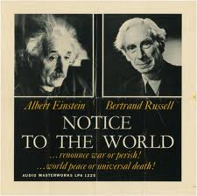

Rotblat (age 47, youngest of signatories)
“We have to learn to think in a new way”

Slide 4
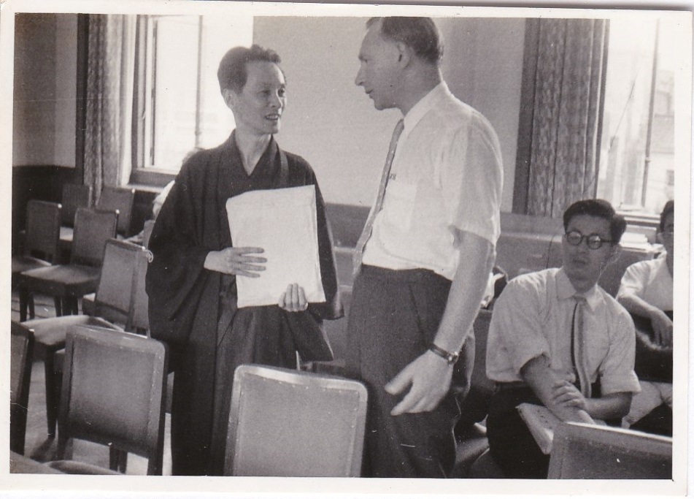
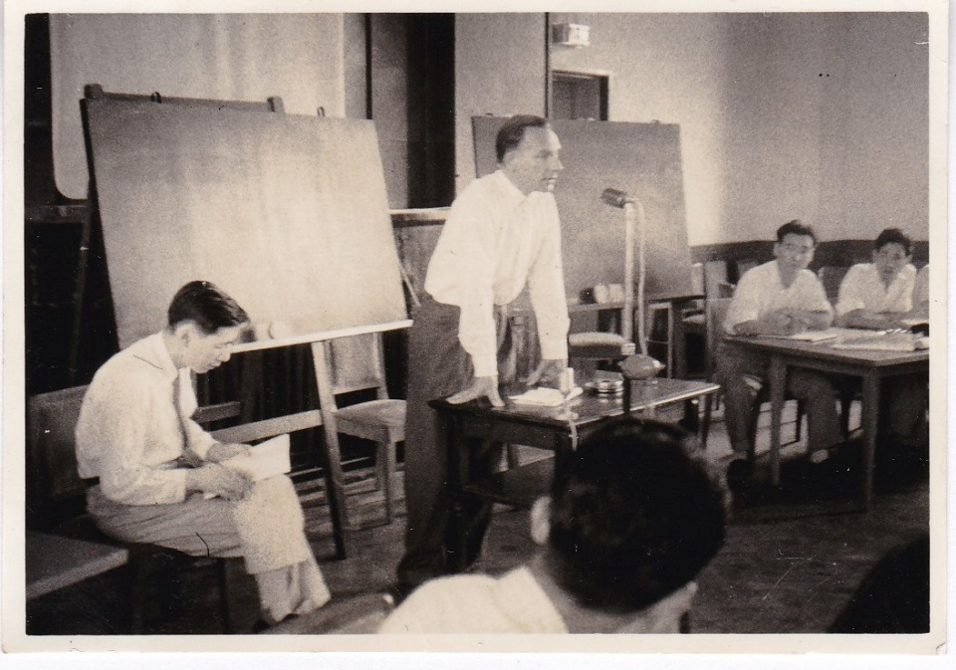
9 August 1957, Tokyo
Rotblat and Tomonaga
Photos Taken by Michiji Konuma (Student, age, 26 Years Old)
Michiji may well be the first ever Student/Young Pugwashite
Japan Pugwash one of the first national Pugwash groups (Statement of 22 Japanese scientists to 2nd Pugwash Conference 1958)
Notes:
The International Expert Meeting on Radioactivity on 9 August 1957 in the Third
World Conference Against A and H Bombs

Slide 5

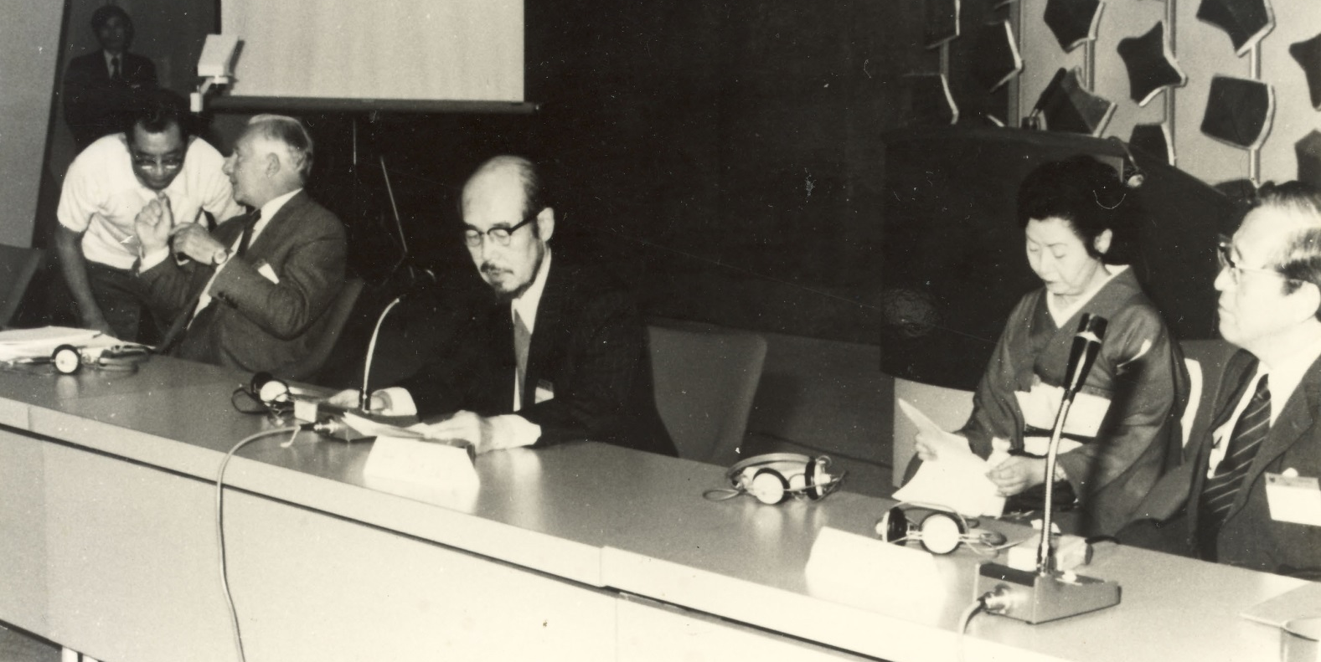
Opening Session
25th Pugwash Symposium
Kyoto, Japan
28th August to 1 September 1975
The first International Pugwash meeting in Japan
Konuma
(staff)
Michiji Konuma, Jo Rotblat, Hideki Yukawa, Sumi Yukawa, Toshiyuki Toyoda

Slide 6
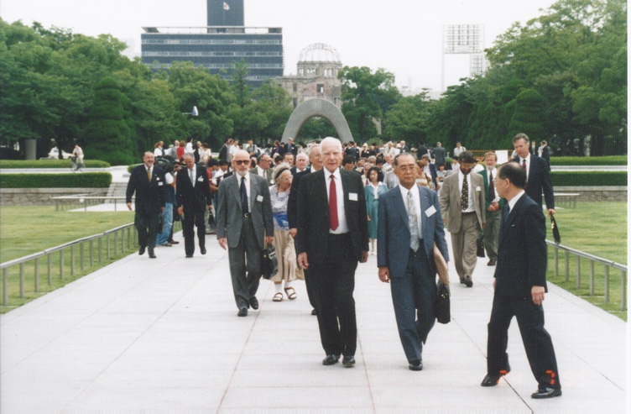

Slide 7
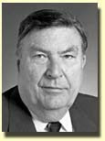
York: “The trick that Pugwash succeeded at was inviting future officials. That’s the trick. That’s the hard part. Primakov wasn’t ex-foreign minister, he became foreign minister.”
York’s advice to young people:
“It’s a question of odds and the biggest thing is opportunity. …Opportunities are related to talent in the sense that you have come to somebody else’s attention because of some talent, even if it’s just for comity, some talent. But the real trick is to then recognize the opportunity and do something about it.”
first director of Lawrence Livermore National Laboratory … at the age of 31 (huge fan of Student Pugwash)

Slide 8
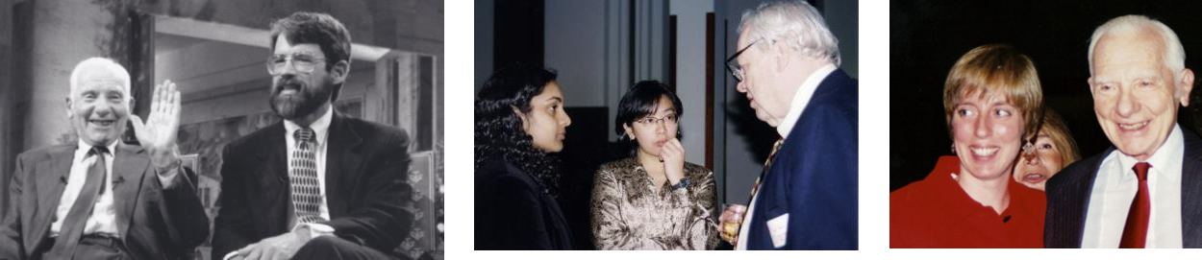
Holdren: “[Rotblat] probably accomplished equally as much through the efforts of others that he inspired, that he has energized, that he has motivated, that he has propelled, that he has embarrassed into doing more on this problem than they would otherwise have done, had Jo Rotblat not been there behind them, educating them, propelling them into the arena”
Rotblat, Holdren Paul Doty & students Oslo, Dec 1955
Doty told Adams at the first conference he was deciding if want ed to do science or get involved in world affairs…he did both

Slide 9
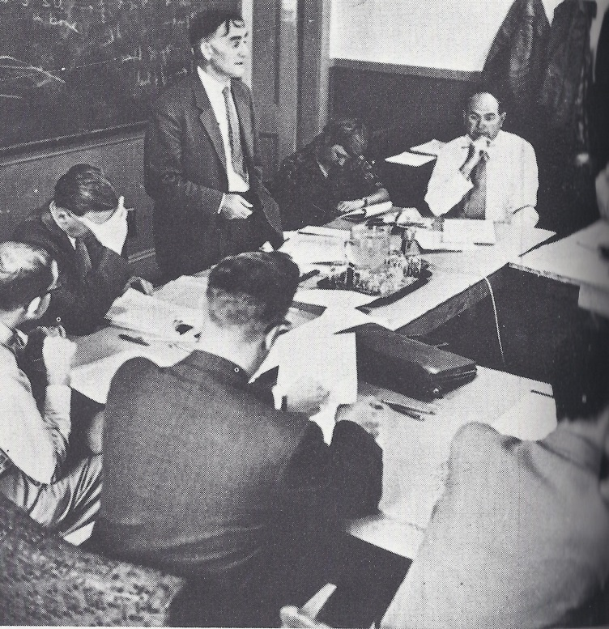
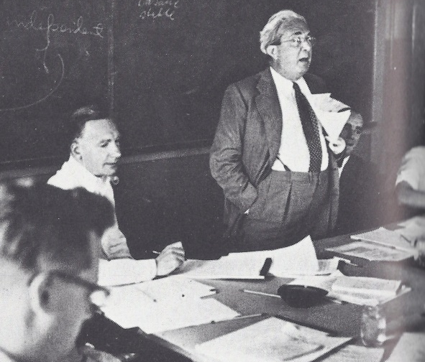
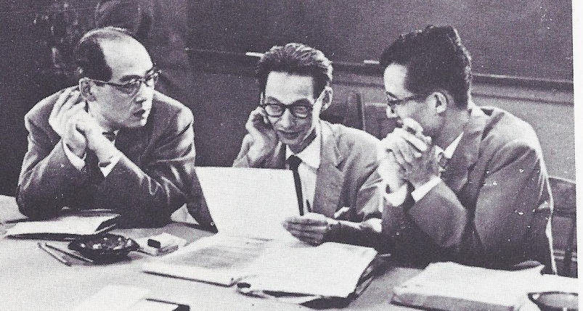
Ruth Adams (34 in 1957): “[T]he birth of Pugwash in that tiny little fishing village was a time of affirmation. I never will forget my first sense of being part of this group, sitting in the little red schoolhouse around a wooden table, marred and scarred through many generations of children, and looking at the faces.
We are all pretty ordinary
…Jo and everybody were a little bit worried about what they were going to say and what they were going to do. One thing carried them through more than anything else—they all had a sense of humor. Despite the perils they felt around them, despite the unique responsibility they felt they had, they still were able to smile and to joke and to reflect upon the joys of being there.”

Slide 10
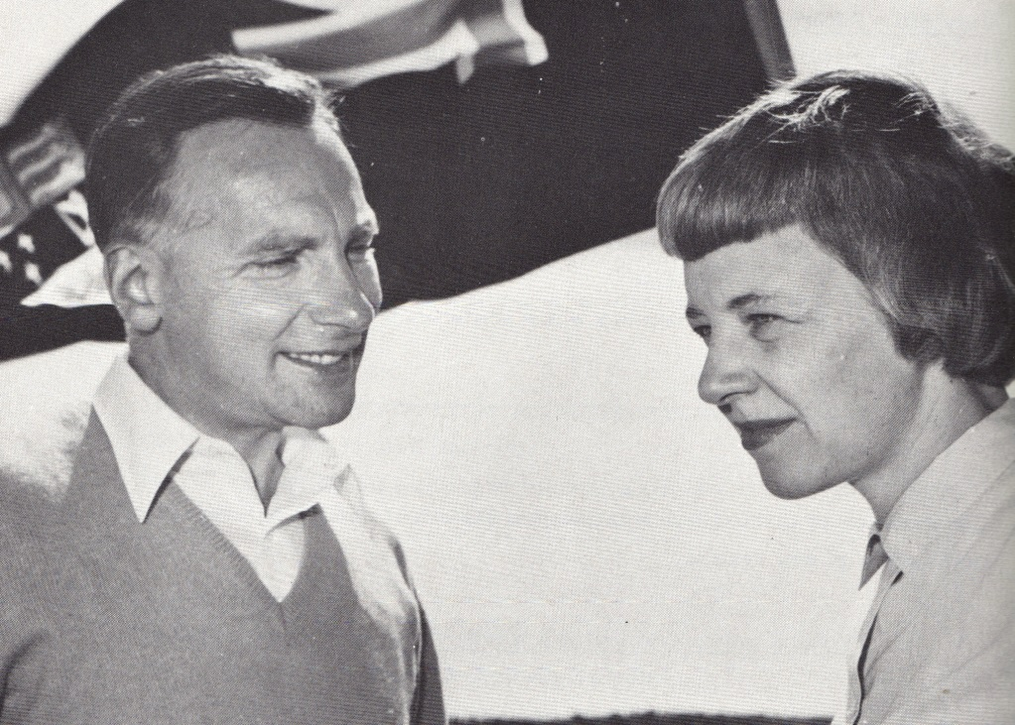
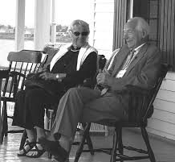
Ruth Adams: “It was a mind boggling experience…as a younger person, sitting in discussions…that commitment and passion for international humanity cut across all those fears, constraints, and even the Iron Curtain. It made it possible for me to enter a life of concern for these issues.”

Slide 11
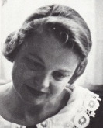
I must mention the marvelous change of atmosphere here as though early on these men decided that although they might not trust each other’s governments, they could trust each other. When I mentioned this to Leo Szilard, he said, “Hah! Who trusts his own government let alone someone elses?”
Nevertheless, Szilard feels the urgency as the other experts do of issuing this warning to the governments of the world. Sitting in the back of the Masonic Hall, taking notes and hearing this urgency in the voices of the experts, is an experience from which I think I will never recover.
July 12, 1957
Pugwash
Nova Scotia
Anne Kinder Eaton
Notes:
April 1978 Bulletin of the Atomic Scientists

Slide 12

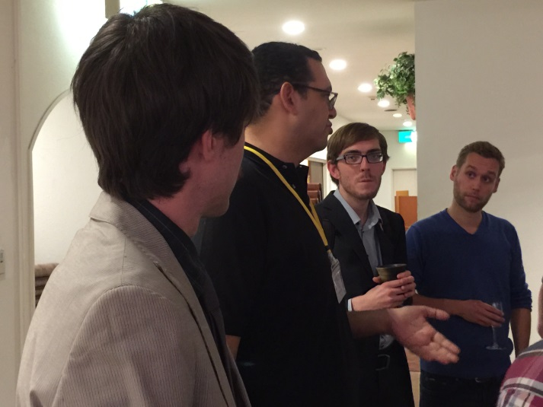
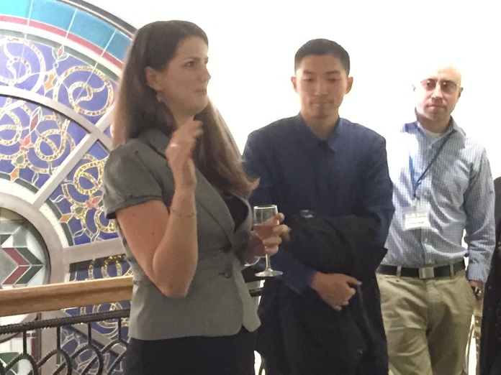
TODAY’S INTERNATIONAL STUDENT/YOUNG PUGWASH
2015 International Student/Young Pugwash Vision Statement:
The Nagasaki Call for Action

Slide 13
“ISYP prepares a new generation of leaders to handle the challenges that they will inevitably face in an increasingly interconnected, complex world. ... We call on Pugwash and the broader disarmament community to help ISYP engage, encourage, and embolden young people to take an active role in solving the difficult international security problems we all face.”
2015 ISYP Vision Statement:
The Nagasaki Call for Action

Slide 14
Ruth Adams (one of her last emails to me)
“As our nation struggles to keep its dream of a just and peaceful society, you and your colleagues carry a heavy responsibility. So if there is strength to share, all I have is yours.”

